Slide 1
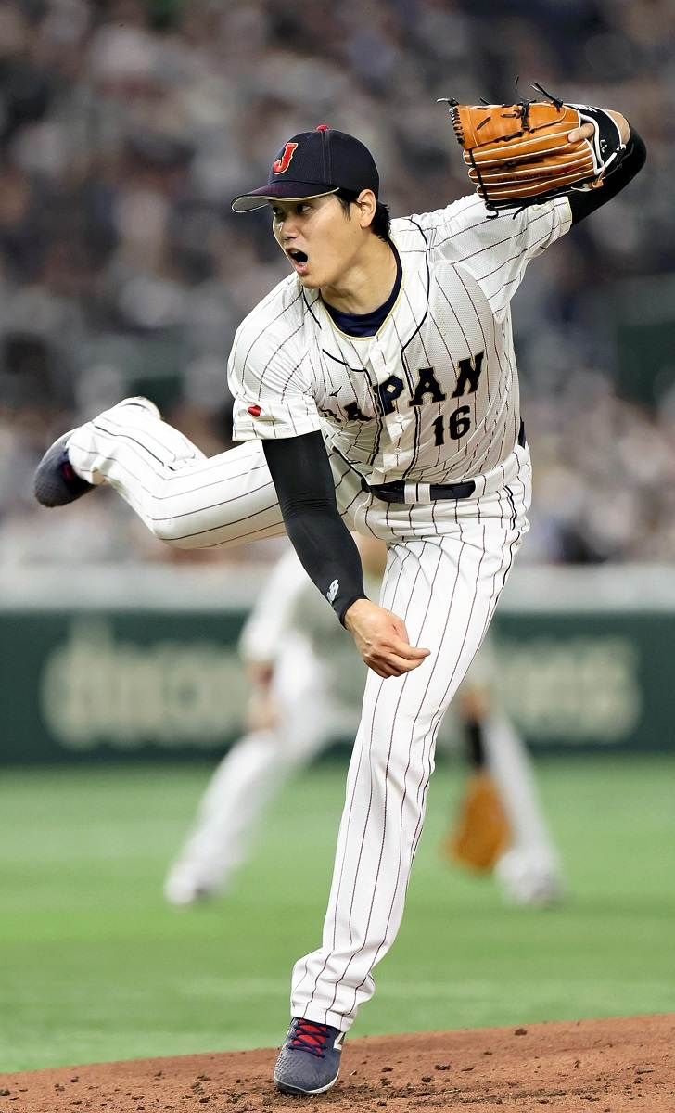
Predicting the Most Effective 5-Pitch Mixes in Major League Baseball
Daiki Sai

Slide 2
Project Objective
Identify the most effective 5-pitch mixes thrown by MLB pitchers
Predict performance using insights from 2- and 3-pitch subcombinations
Evaluate combinations using run value, whiff rate, and hard-hit percentage
Recommend optimal arsenals based on statistical modeling
Hassan Khoury ©

Slide 3
Datasets Used
Pitch-Arsenal Stats (2022–2024): Individual pitch performance (run value, usage %, whiff rate, etc.)
Savant-Level Pitcher Data (2022–2024): Pitcher-level season summaries
Combined across all three seasons for robust sample size
Hassan Khoury ©

Slide 4
Methodology Overview
Evaluate each pitch type individually using performance metrics
Create all 2- and 3-pitch combinations from full pitch type pool
Use these submix scores to inform potential 5-pitch mixes
Simulate velocity proxies and engineer velocity features
Train predictive models to estimate 5-mix run value
Hassan Khoury ©

Slide 5
Models Used
Linear Regression:
Interpretable, efficient for structured numeric data
Random Forest:
Nonlinear, captures interaction effects and variable importance
K-Nearest Neighbors (KNN) Regression:
Instance-based model using distance-weighted local averaging
Target Variable:
Average run value per 100 pitches for the 5-pitch mix
Hassan Khoury ©

Slide 6
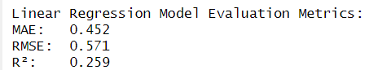
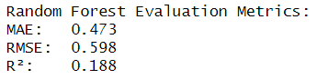
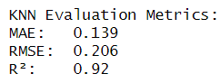
Models Evaluation
Conclusion:
KNN outperformed all other models, suggesting that similar pitch mixes share strong predictive structure.
Hassan Khoury ©

Slide 7
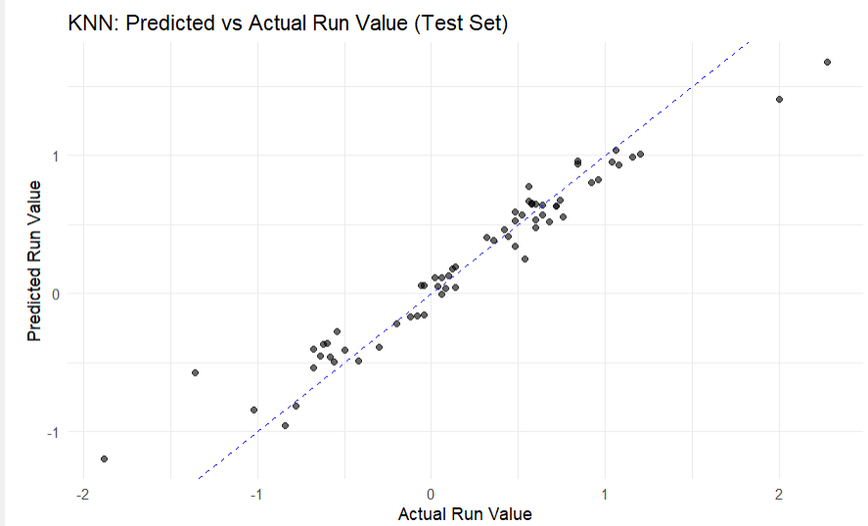
KNN Model Evaluation
Key Insights:
Predictions from the KNN model closely align with actual values
Strong clustering along the diagonal suggests low error and high accuracy
Very few outliers, confirming model generalization to unseen data
Hassan Khoury ©

Slide 8
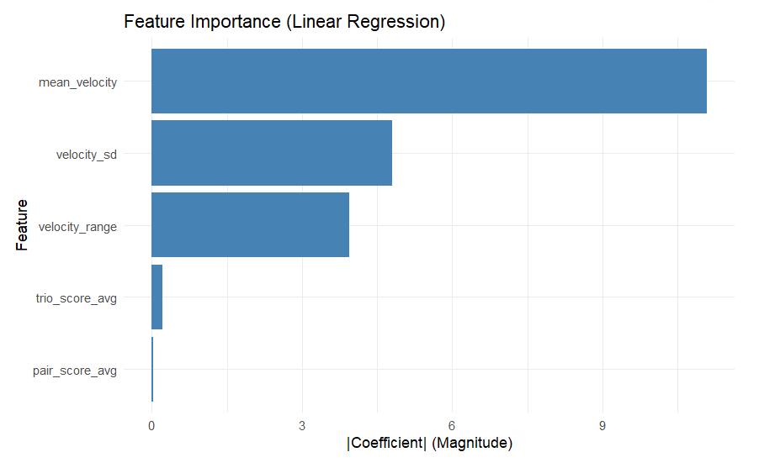
Feature Importance (Linear Model)
Top feature: Mean Velocity
Other predictors (submix scores, spread metrics) were less influential
Hassan Khoury ©

Slide 9
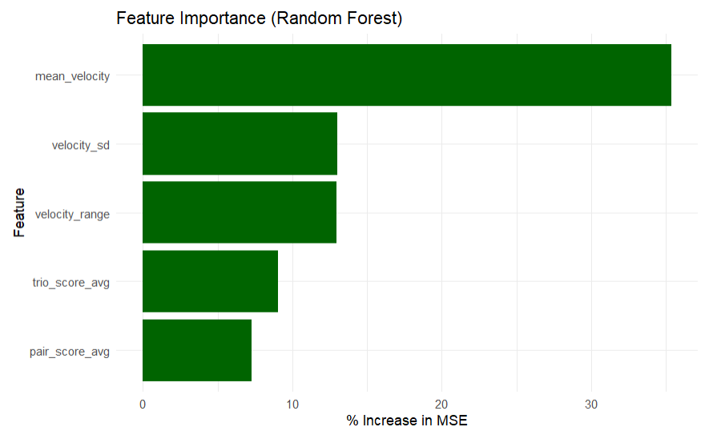
Feature Importance (Random Forest)
Top predictors (by %IncMSE):
Mean Velocity
Velocity SD
Trio Submix Score
Hassan Khoury ©

Slide 10
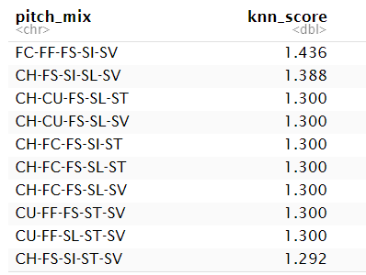
Top 10 Predicted 5-Pitch Mixes (KNN Model)
Insights from Top KNN Pitch Mixes:
The most effective predicted mix was FC-FF-FS-SI-SV with a score of 1.436
Most top mixes include:
Two types of fastballs (e.g., FC, FF, SI)
At least one off-speed (e.g., CH or FS)
A slider (SL) or sweeper (SV) as a breaking pitch
Common Pitch Types Across Top Mixes:
SI (Sinker) and SL (Slider) appear in 9/10 mixes
SV (Sweeper) present in all top 10 — likely due to horizontal break complementing other pitches
CH (Changeup) often used to disrupt timing when paired with velocity-heavy combos
Hassan Khoury ©

Slide 11
Key Takeaways
Mean velocity was consistently the most important feature across models
KNN outperformed other models significantly (R² = 0.92)
Submix synergy (2-pitch & 3-pitch performance) adds predictive value
Best-performing mixes combine fastball velocity with off-speed/breaking variety
Hassan Khoury ©

Slide 12
Future Work
Incorporate real release_speed and spin_rate instead of proxies
Add pitcher-specific context: handedness, pitch count, sequencing
Test generalizability on held-out 2024-only data
Develop interactive tool for teams to explore mix performance dynamically
Hassan Khoury ©

Slide 13
Q&A

